Slide 1

DESKTOP AS A ROUTER
A Router is a networking device that forwards data packets between computer networks.
The most familiar type of routers are big organization level router and small office routers that simply forward IP packets between the home computers and the Internet.

Slide 2
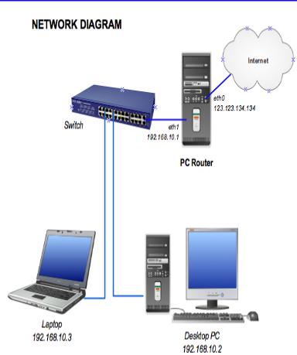

Slide 3
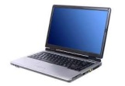
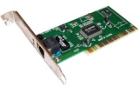
REQUIREMENTS
HARDWARE REQUIEMENTS: -
1.Computer -For configuring to work as a router.
2.Lap tops or computers-For testing.
3.NIC (Network Interface Card)-For adding extra RJ45 port.

Slide 4
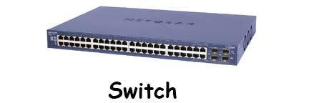
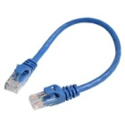
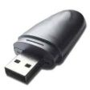
4.Switch-For adding more hosts. 5.LAN cables-For connecting different networks 6.Removable Device (Portable Pen Drive)- For installation of vyos software

Slide 5
SOFTWARE REQUIREMENT
vyos 1.1.7-i586 - Networking Software.
rufus-2.18 - For making a networking software system Bootable.
command prompt - For checking connectivity between networking Devices

Slide 6
DESCRIPTION
STEP 1: - MAKE PENDRIVE BOOTABLE
1.Take a portable pen drive and insert into the computer or laptop.
2.Download and Install rufus -2.18 .
3. Select pen drive location as well as the image location of vyos
1.1.7-i586 in rufus-2.18 software and click on start button.
4.After completion of booting process detach the pen drive from the computer or laptop.

Slide 7
DESCRIPTION
STEP 2: - INSERT NETWORK INTERFACE CONROLLER OR CARD INTO PCI SLOT.
1.Insert NIC into Expansion slot, (nothing but the PCI slot)
2.Insert the pen drive into a USB port on your computer.
3. Power on the CPU . & configure the system.

Slide 8
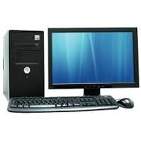



CONNECTING LAN CABLE BETWEEN COMPUTER

Slide 9
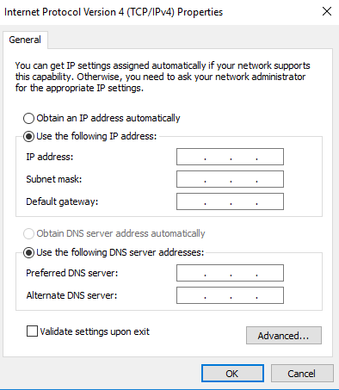
ASSIGN IP ADDRESS TO NETWORK

Slide 10
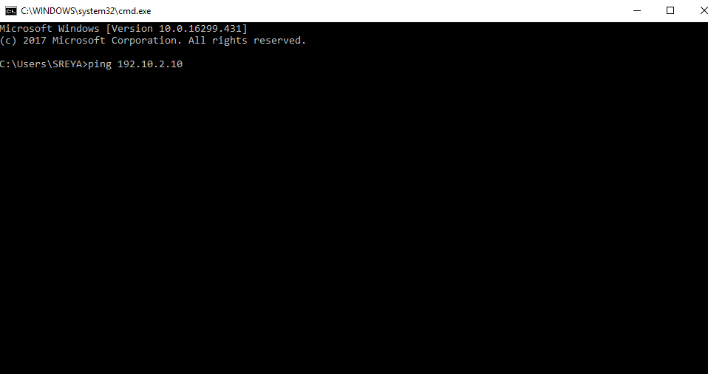
PING NETWORKS

Slide 11


